Slide 1
Amyotrophic Lateral Sclerosis
(ALS; Lou Gehrig’s disease)

Slide 2
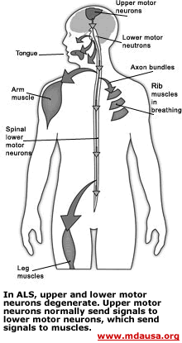
ALS is a “motor-neuron” disease, a neurodegenerative disease characterized by the selective death/degeneration of upper motor neurons (in the brain) and lower motor neurons (in the spinal cord). The upper motor neurons normally send the signals to the lower motor neurons, which send signals to muscles.

Slide 3
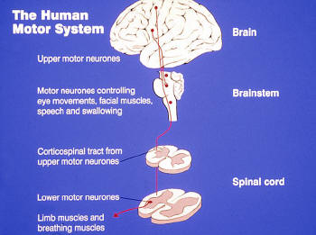
www.alsa.org

Slide 4
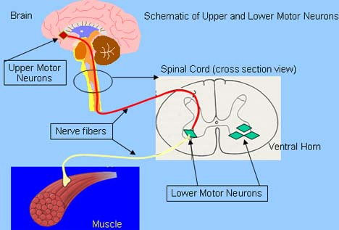
www.alsa.org

Slide 5
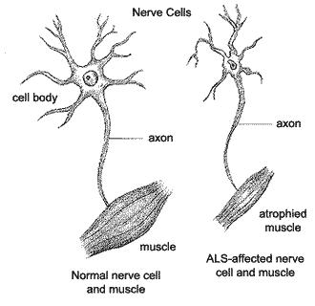
A-myo-trophic Lateral Sclerosis
Amyotrophic: no muscle nourishment
Lateral: refers to the the areas in a person's spinal cord where portions of the nerve cells that signal and control the muscles are located
Sclerosis: scarring of the affected nerves

Slide 6
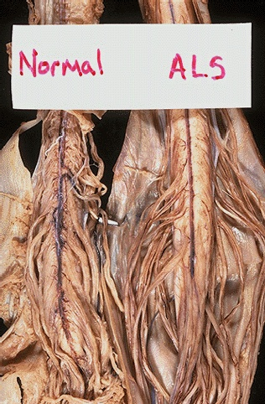
Severe atrophy of anterior spinal roots in motorneuron disease
Amyotrophic lateral sclerosis (ALS) is uncommon. It begins in middle age and proceeds to death in several years. There is loss of anterior horn cells, so that patients present with progressive weakness that proceeds to paralysis from neurogenic muscular atrophy. Because of the loss of anterior horn cells, the anterior (ventral) spinal motor nerve roots demonstrate atrophy, as seen here in comparison with normal ventral spinal cord nerve roots.
http://library.med.utah.edu/WebPath/CNSHTML/CNS103.html

Slide 7
Symptoms
Earliest signs:
1-twitching (fasciculation), stiffness, cramping
2-weakness of the arms and of the legs. This results in an increased frequency of stumbling on uneven pavement or difficulty in climbing stairs. Arm weakness may lead to difficulty in grasping or holding a cup, for instance, or loss of coordination in fingers
3-more rarely, weakness of the muscles of the mouth. This results in difficulties for the patient to chew, swallow and speak.
Later signs:
The progression of the disease is accompanied by weight loss, fatigue, exaggerated reflexes, and decreased coordination. Ultimately, patients cannot walk, stand, eat, or breath without assistance. Increased susceptibility to pneumonia and respiratory failure causes half to die within three years.
However, muscles that controls eye movements and urinary sphincters are spared.

Slide 8
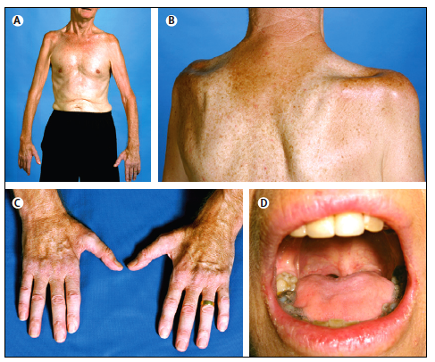
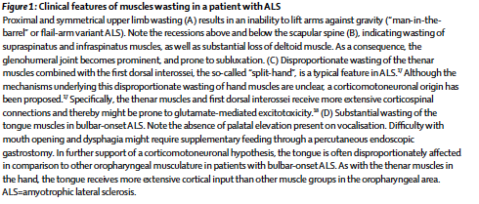
Muscular atrophy in ALS: Wasting
Man-in-the-barrel
Sovraspinatus
Infraspinatus muscle
Tongue muscle
Thenar Muscle

Slide 9
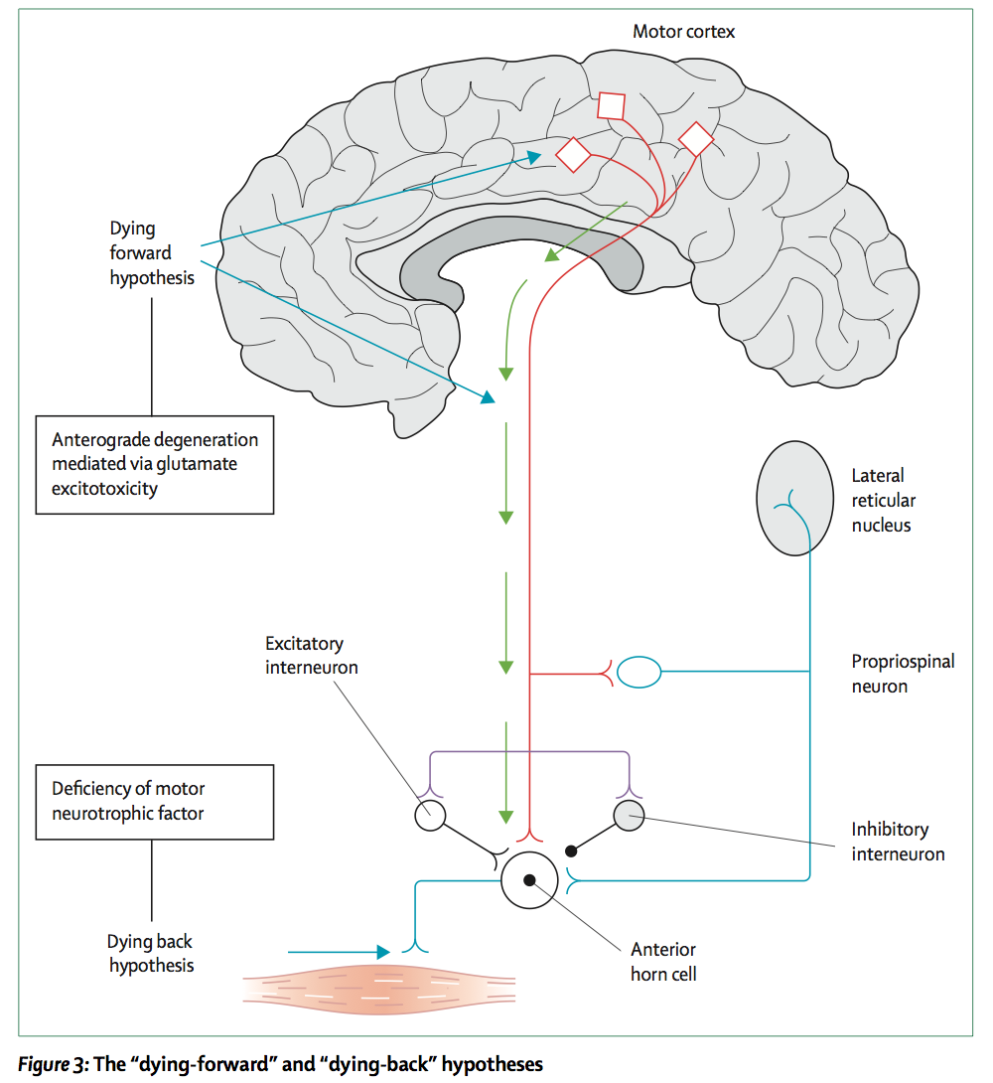
Neurodegeneration:
Dying Forward
&
Dying Back
Hypotheses

Slide 10
Epidemiology of ALS
Incidence: 1-2 in 100,000 each year. At the moment in the U.S. there are 25,000 people affected by the disease. Median age of onset is 55 years old. Gender-related incidence: female:male ratio is 4:5.
10% of the cases are inherited, familial cases (FALS), whereas the 90% of the cases are sporadic (SALS)
The life-span of a patient affected by ALS is 3 to 5 years, after the diagnosis.

Slide 11
Diagnosis of ALS
-No biological marker has been identified yet.
-Series of clinical and neurological exams
-MRI
-myelogram of cervical spine (an x-ray analysis that allows the detection of lesions in selected area of the spinal cord)
muscle and/or nerve biopsy
electromyography (EMG) and nerve conduction velocity (NCV), to measure muscle response to nervous stimulation.

Slide 12
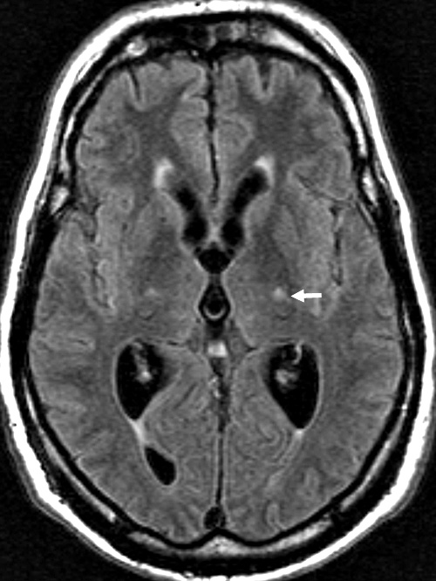
MRI in Amyotrophic Lateral Sclerosis (ALS)

Slide 13
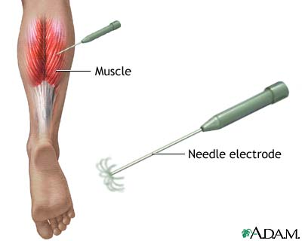
Electromyography (EMG)
A needle electrode is inserted through the skin into the muscle. Each muscle fiber that contracts will produce an action potential. The presence, size, and shape of the wave form of the action potential produced on the oscilloscope, provides information about the ability of the muscle to respond to nervous stimulation.

Slide 14
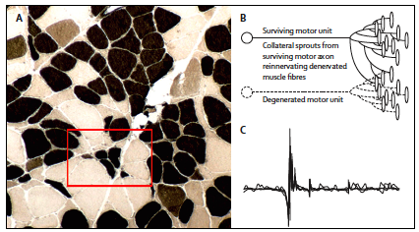

Atrophic muscle fibers in ALS patients

Slide 15
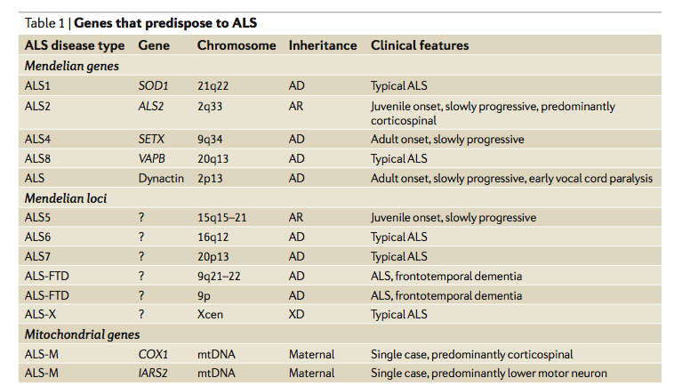
Genetic of ALS

Slide 16
Is ALS a mitochondrial disease?

Slide 17
Evidences of mitochondrial dysfunction in ALS:
-mitochondria aggregate in skeletal muscle and intramuscular nerve
-mitochondria show abnormalities in proximal axons and nerves of the anterior horn of spinal cord
-increased mitochondrial volume and calcium level
-dysfunction of mitochondrial complex I and IV
Decreased ATP production

Slide 18
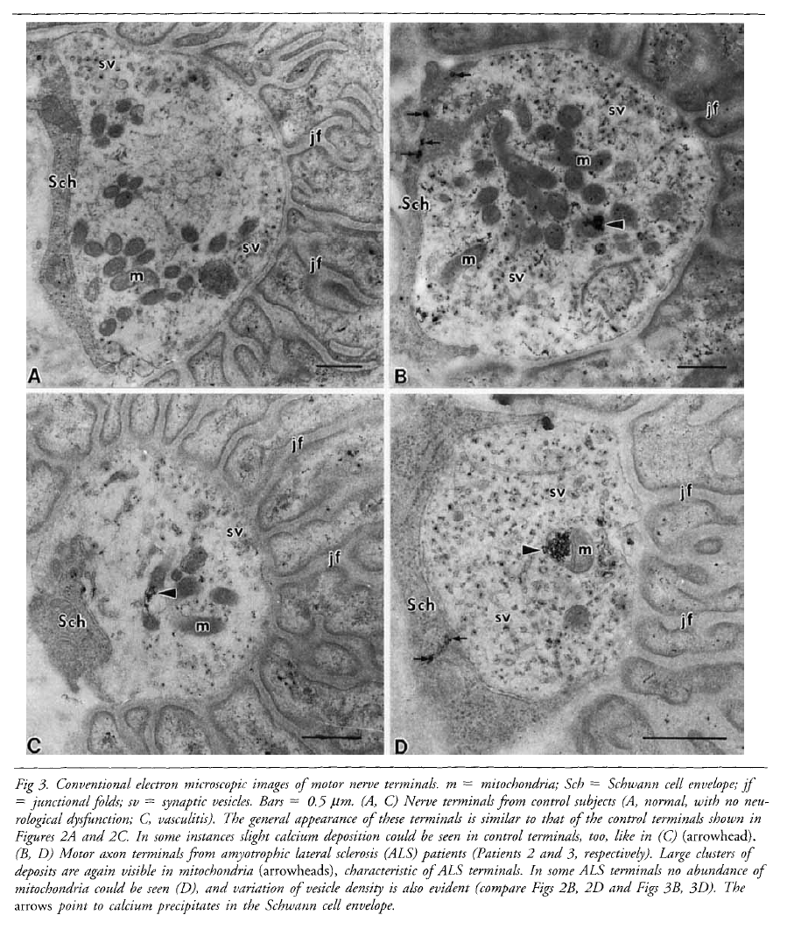
CONTROL
ALS
Calcium deposits in mitochondria of ALS patients
Syklos et al.,

Slide 19
Superoxide Dismutase 1 SOD1
SOD1 is a ubiquitous mostly cytosolic protein
SOD1 is comprised of 153 aa with an approximate molecular weight of 16kDa and is an active homodimer
Each of the two dimers of SOD1 binds a Cu⁺⁺ and a Zn⁺⁺ ion. The reduction of Cu⁺⁺ to Cu⁺ is behind the mechanism of SOD1 in regulating the dismutation of superoxide ion O₂^{-.} into hydrogen peroxide H₂O₂
Cu²⁺ + O^{2-·} Cu⁺ + O₂
Cu⁺ + O^{2-·} + 2H⁺ Cu²⁺ + H₂O₂
2 O^{2-·} + 2H⁺ H₂O₂ + O₂
A catalase will subsequently reduce hydrogen peroxide to water.

Slide 20
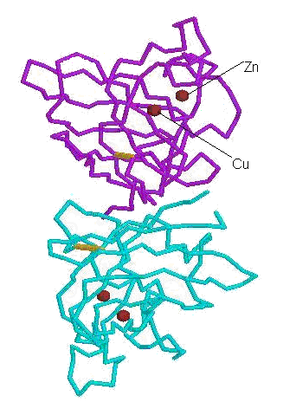
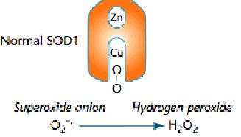
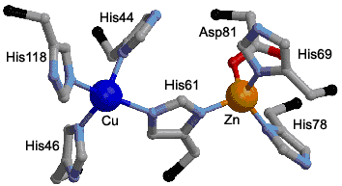
SOD1 structure: the functional homodimer

Slide 21
Most common mutations in SOD1 related FALS

Slide 22
SOD1 and FALS
-More than 125 mutations have been found on the SOD1 gene, 114 are related to ALS, most of them are missense mutations, only 12 are nonsense mutations or deletion mutants.
-Most mutations reduce dismutation activity, however others retain full dismutase activity, still are related to the disease. Moreover, there is NO CLEAR CORRELATION between enzyme activity and progression of the disease.
-In addition, in animal models, gene KO for SOD1 does not cause motorneuron disease, whereas overexpression of SOD1 does.
In this respect, the simple manipulation of SOD1 dismutase activity IS NOT necessarily behind ALS/motorneuron disease.

Slide 23
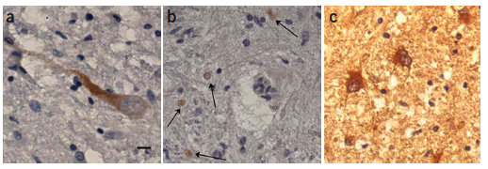
SOD1 misfolds and aggregates in FALS SOD1A4V motorneurons
SEDI Ab
SEDI-reactive SOD1
SOD1

Slide 24
Possible roles of mutant SOD1 in FALS
Loss of physiological function: impaired dismutase activity
Gain of toxic function:
1) Aberrant redox chemistry, probably due to changes in the conformation of SOD1, that leave the channel (the portion of the molecule accepting superoxide ion, i.e.) able to accept larger molecules. This can lead to peroxidation, tyrosine nitrosylation and reverse catalysis (due to improper binding of Zn⁺⁺ to the molecule that leads to formation of superoxide ion rather than dismutase activity). These activities are not a characteristic of ALL SOD1 mutations, thus remain partially controversial.
2) Protein instability and SOD1 aggregation. These activities are characteristic of all SOD1 mutants.

Slide 25
Mutant SOD1 may mediate cytotoxic reactions involving: 1) Copper catalysis/Zn-mediated toxicity 2) Protein aggregation
4
4
1
1
H
O
H
O
Zn
Cu
Zn
O-O…Cu
Cu
O-O…Cu
Zn
Zn
H
H
O
O
WT
WT
2
3
2
3
.OH
.OH
Peroxidation
Aggregation
Peroxidation
Aggregation
Cu
Cu
ONOO
Zn
ONOO
Zn
toxic
toxic
Cu
Cu
Zn
toxic
Zn
toxic
NO-Tyr
NO-Tyr
Cu, Zn Toxicity
Cu, Zn Toxicity
Tyrosine Nitration
Tyrosine Nitration
P.Pasinelli

Slide 26
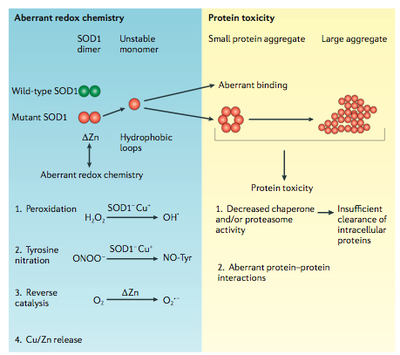
Models of mutant SOD1-mediated toxicity

Slide 27
How SOD1 aggregates could be toxic?
Mitochondrial dysfunction and apoptosis
Studies in FALS

